Slide 1
Lecture #21
SOFT COMPUTING
INT508
Genetic Algorithm

Slide 2
General Introduction to GAs
Genetic algorithms (GAs) are the main paradigm of evolutionary computing. GAs are inspired by Darwin's theory about evolution – the "survival of the fittest".
In nature, competition among individuals for scanty resources results in the fittest individuals dominating over the weaker ones.
    GAs are intelligent exploitation of random search used in optimization problems.
    GAs, although randomized, exploit historical information to direct the search into the region of better performance within the search space.
12/12/14
CSE510, Lovely Professional University, Phagwara

Slide 3
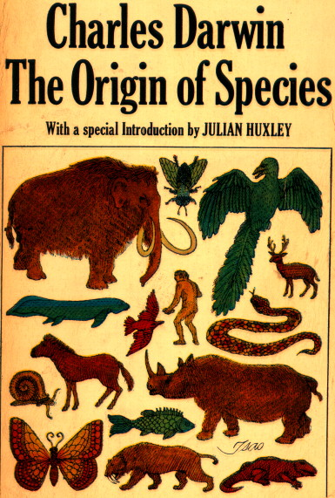
General Introduction to GAs
  Genetic algorithms (GAs) are a technique to
  solve problems which need optimization.
  GAs are a subclass of Evolutionary Computing and are random search algorithms.
  History of GAs:
    Evolutionary computing evolved in the 1960s.
    GAs were created by John Holland in the mid-1970s.

Slide 4
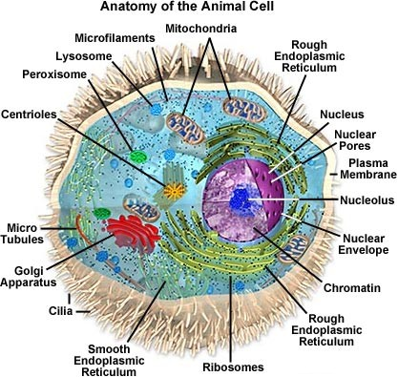
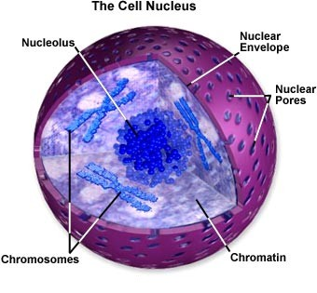
Biological Background (1) – The Cell
  The center of this all is the cell nucleus.
  The nucleus contains the genetic information.

Slide 5
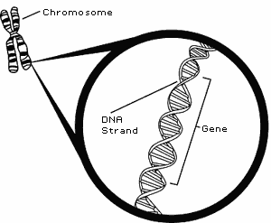
Biological Background (2) – Chromosomes
Every organism has a set of rules, describing how that organism is built. All living organisms consist of cells.
In each cell there is same set of chromosomes. Chromosomes are strings of DNA and serve as a model for the whole organism.
  Each chromosome is build of DNA (Deoxyribonucleic acid).
  Chromosomes in humans form pairs.
  There are 23 pairs.
  The chromosome is divided in parts: genes.

Slide 6
Biological Background (3) – Chromosomes
Each gene encodes a particular protein that represents a trait (feature), e.g., color of eyes
Possible settings for a trait (e.g. blue, brown) are called alleles.
Each gene has its own position in the chromosome called its locus.
Complete set of genetic material (all chromosomes) is called a genome.
Particular set of genes in a genome is called genotype.
The physical expression of the genotype (the organism itself after birth) is called the phenotype, its physical and mental characteristics, such as eye color, intelligence etc.

Slide 7
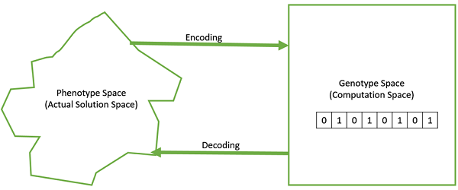
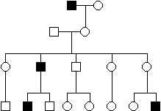
Biological Background (4) – Genetics
  A genotype develops into a phenotype.
  Alleles can be either dominant or recessive.
  Dominant alleles will always express from the genotype to the phenotype.
  Recessive alleles can survive in the population for many generations without being expressed.

Slide 8
Biological Background (5) – Genetics
When two organisms mate they share their genes; the resultant offspring may end up having half the genes from one parent and half from the other. This process is called recombination (cross over) .
The new created offspring can then be mutated. Mutation means, that the elements of DNA are a bit changed. This changes are mainly caused by errors in copying genes from parents.
The fitness of an organism is measured by success of the organism in its life (survival).

Slide 9
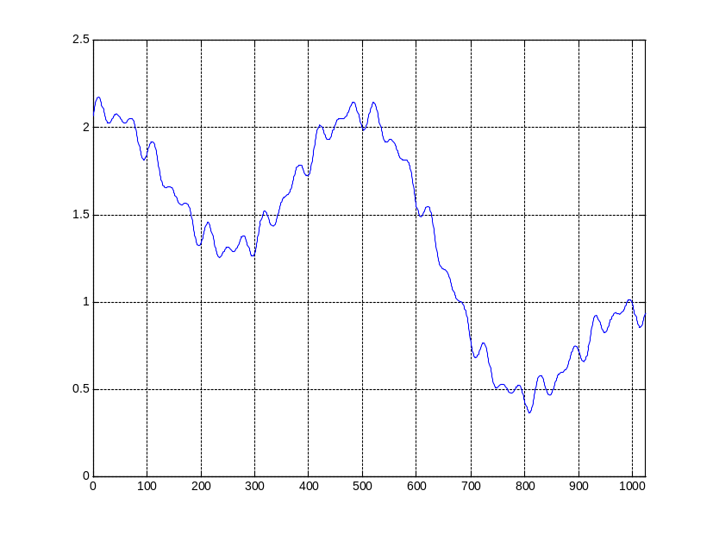
Genetic Algorithm (1) – Search Space
  Most often one is looking for the best solution in a specific subset of solutions.
  This subset is called the search space (or state space).
  Every point in the search space is a possible solution.
  Therefore every point has a fitness value, depending on the problem definition.
  GAs are used to search the search space for the best solution, e.g. a minimum.
  Difficulties are the local minima and the starting point of the search.

Slide 10
Genetic Algorithm (2) – Basic Algorithm
  Starting with a subset of n randomly chosen
  solutions from the search space (i.e. chromosomes).
  This is the population.
  This population is used to produce a next generation of individuals by reproduction.
  Individuals with a higher fitness have more chance to reproduce (i.e. natural selection).

Slide 11
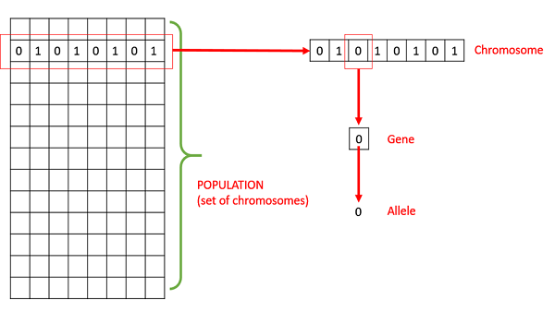
Biological Background (2) – Chromosomes

Slide 12
Comparison of Natural and GA Terminology
Natural | Genetic Algorithm
Chromosome Gene Allele Locus Genotype Phenotype | String Feature or character Feature value String position Structure Parameter set, a decoded structure

Slide 13
Working Principles
Chromosome : a set of genes; a chromosome contains the solution in form of genes.
Gene : a part of chromosome; a gene contains a part of solution. It determines the solution. e.g. 16743 is a chromosome and 1, 6, 7, 4 and 3 are its genes.
Individual : same as chromosome.
Population: number of individuals present with same length of chromosome.

Slide 14
Working Principles
Fitness :the value assigned to an individual based on how far or close a individual is from the solution; greater the fitness value better the solution it contains.
Fitness function : a function that assigns fitness value to the individual. It is problem specific.
Breeding : taking two fit individuals and then intermingling there
chromosome to create new two individuals.
Mutation : changing a random gene in an individual.
Selection : selecting individuals for creating the next generation.

Slide 15
Genetic Algorithm– Basic Algorithm
  Outline of the basic algorithm
0 START : Create random population of n chromosomes
1 FITNESS : Evaluate fitness f(x) of each chromosome in the population
2 NEW POPULATION
1 REPRODUCTION/SELECTION : Based on f(x)
2 CROSS OVER : Cross-over chromosomes
3 MUTATION : Mutate chromosomes
3 REPLACE : Replace old with new population: the new generation
4 TEST : Test problem criterium
5 LOOP : Continue step 1 – 4 untill criterium is satisfied

Slide 16
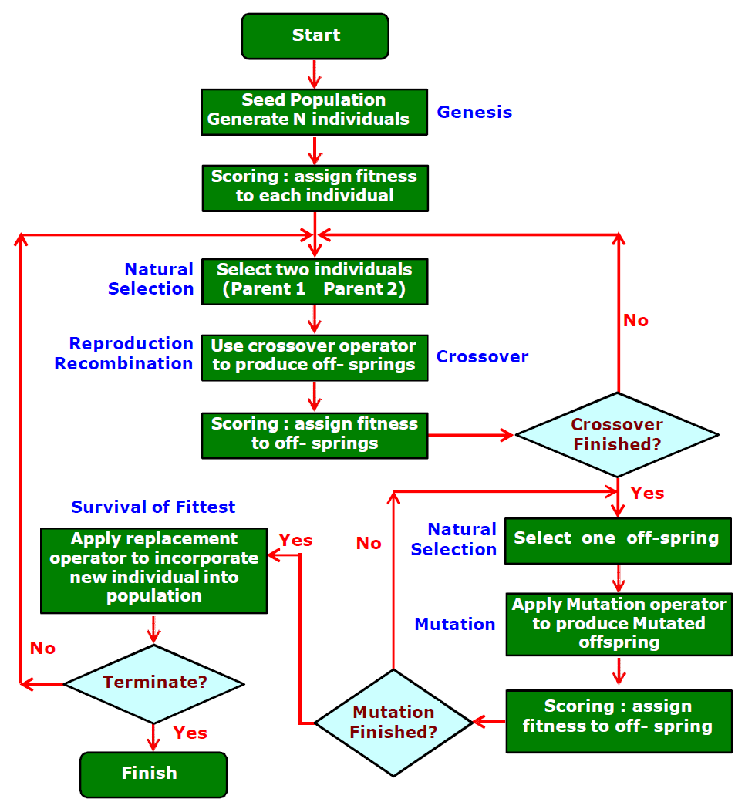
Genetic Algorithm– Basic Algorithm
  Outline of the basic algorithm

Slide 17
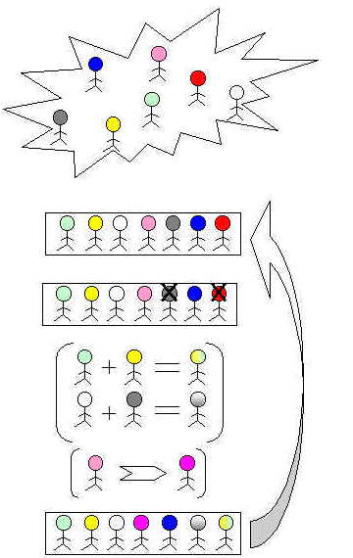
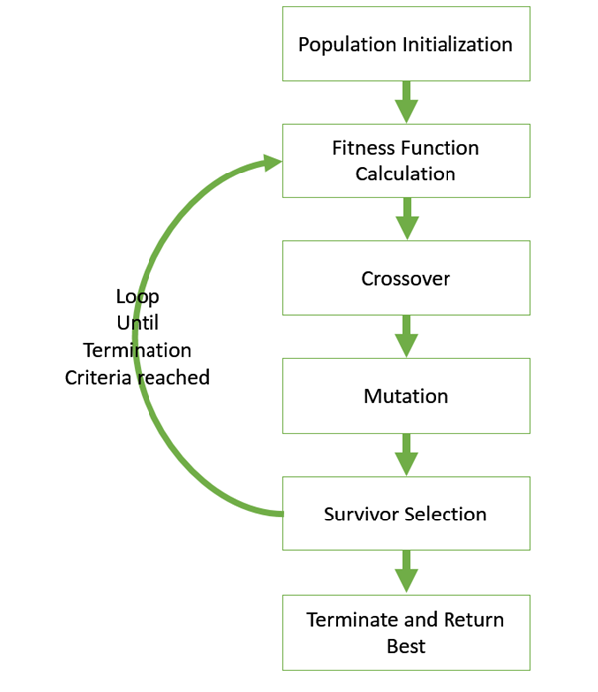

Slide 18
Q & A
1. Genetic algorithms are example of
A: heuristic
B: Evolutionary algorithm
C: ACO
D: PSO

Slide 19
Q & A
1. Genetic algorithms are example of
A: heuristic
B: Evolutionary algorithm
C: ACO
D: PSO

Slide 20
Q & A
2. Fitness function should be
A: maximum
B: minimum
C: intermediate
D: noneof these

Slide 21
Q & A
2. Fitness function should be
A: maximum
B: minimum
C: intermediate
D: noneof these

Slide 22
Q & A
3. Genetic algorithms are example of
A: heuristic
B: Evolutionary algorithm
C: ACO
D: PSO

Slide 23
Q & A
3. Genetic algorithms are example of
A: heuristic
B: Evolutionary algorithm
C: ACO
D: PSO

Slide 24
Q & A
4. Parameters that affect GA
A: initial population
B: selection process
C: fitness function
D: all of these

Slide 25
Q & A
4. Parameters that affect GA
A: initial population
B: selection process
C: fitness function
D: all of these

Slide 26
Q & A
5. EV is dominantly used for solving ___.
A: optimization problems
B: NP problem
C: simple problems
D: none of these

Slide 27
Q & A
5. EV is dominantly used for solving ___.
A: optimization problems
B: NP problem
C: simple problems
D: none of these

Slide 28

12/12/14
CSE510, Lovely Professional University, Phagwara

